Slide 1
MATHEMATICS NUMBER THEORY
2nd SEM
SEMINAR

Slide 2
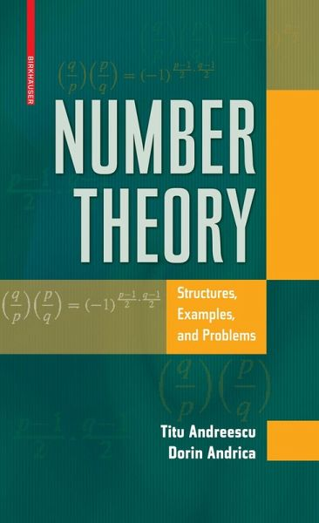
20MAT112
PROJECT
SUDIPT KUMAR
ROHIT REDDY
PAVAN KUMAR
MANOJ RAM
RAVI CHANDRA
GANASEKHAR
DHARMIK
SREE OM SHARMA
HEMESH SAI

Slide 3
TABLE OF CONTENTS
01
03
PRIMALITY TEST
PSEUDO PRIMALITY TEST
02
04
FERMAT TEST
SQUARE ROOT TEST

Slide 4
INTRODUCTION
Primality test is a criterion for a large number p to be checked whether it is prime or non - prime.

Slide 5

WHAT IS THIS TOPIC ABOUT?
Fermat Little Theorem:
If p is prime, p ∤ a (or gcd (a,p)=1) or 0 < a < p then it should satisfy
a^{p-1} ≡ 1 (mod p)

Slide 6
FERMAT TEST!
To Test Primality of a number p using Fermat’s theorem:
Step 1: Choose all the possible integers for a such that (a,p)=1
Step 2: Test
a^{p-1} ≡ 1 (mod p) -Eq 1
If congruence 1 fails for any a then p is not prime
FERMAT THEOREM SAYS IF P IS PRIME ;(A,P)=1 THEN IT MUST SATISFY a^{p-1} ≡ 1 (mod p)

Slide 7
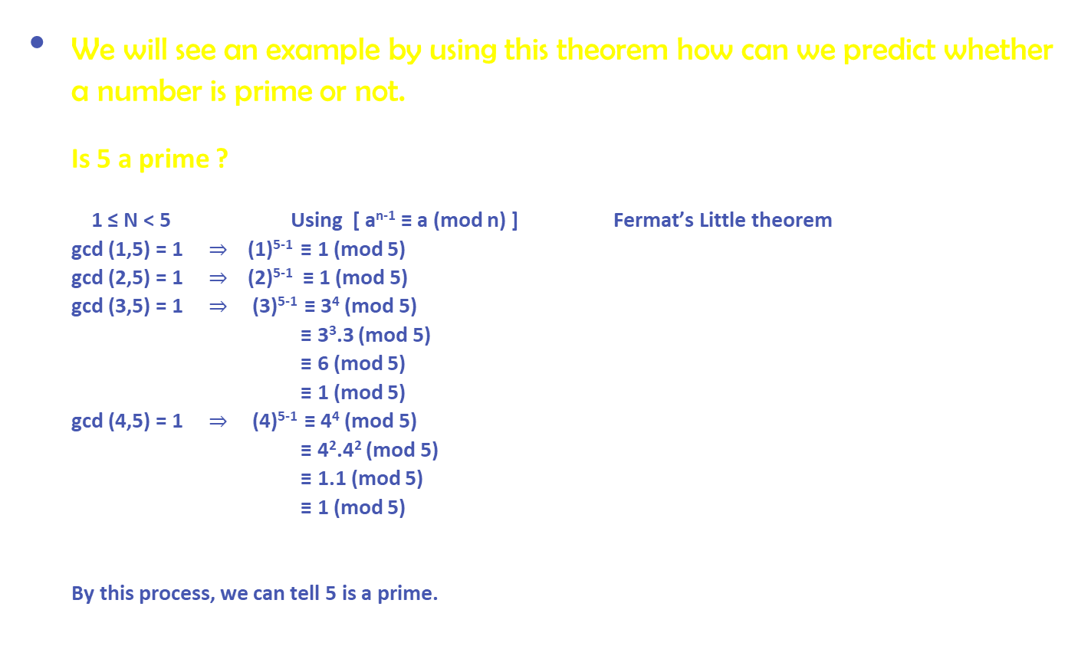
We will see an example by using this theorem how can we predict whether a number is prime or not. Is 5 a prime ? 1 ≤ N < 5 Using [ a^{n-1} ≡ a (mod n) ] Fermat’s Little theorem gcd (1,5) = 1 $⇒$ (1)⁵⁻¹ ≡ 1 (mod 5) gcd (2,5) = 1 $⇒$ (2)⁵⁻¹ ≡ 1 (mod 5) gcd (3,5) = 1 $⇒$ (3)⁵⁻¹ ≡ 3⁴ (mod 5) ≡ 3³.3 (mod 5) ≡ 6 (mod 5) ≡ 1 (mod 5) gcd (4,5) = 1 $⇒$ (4)⁵⁻¹ ≡ 4⁴ (mod 5) ≡ 4².4² (mod 5) ≡ 1.1 (mod 5) ≡ 1 (mod 5) By this process, we can tell 5 is a prime.

Slide 8
If a prime number p is big then this process has to be carried out till p for the numbers whose gcd (a,p) = 1. This algorithm is not deterministic method but probabilistic method because the algorithm might give wrong output.
DRAWBACKS:

Slide 9
What happens if we find a number n such that a^{p-1} ≡ 1 (mod p) ? Can we conclude that n is certainly a prime? The answer is unfortunately not because n sometimes is indeed a prime, but sometimes is not
FOR EXAMPLE:
2³⁴¹⁻¹ ≡ 2³⁴⁰ (mod 341)
≡ 1 (mod 341) but 341 is not a prime
4¹⁴ ≡ 1 (mod 15) but 15 is not a prime
Here comes the concept of Fermat Pseudo primality test

Slide 10
FERMAT PSEUDO PRIMALITY TEST
TERMINOLOGY:
Pseudo prime : A composite number n is called pseudo prime to the base a, whenever n|a^{n_} a(or) a^{n-1} ≡ 1 (mod n).
Ex :The first few base-2 pseudoprimes are as follows : 341, 561, 645, 1105

Slide 11
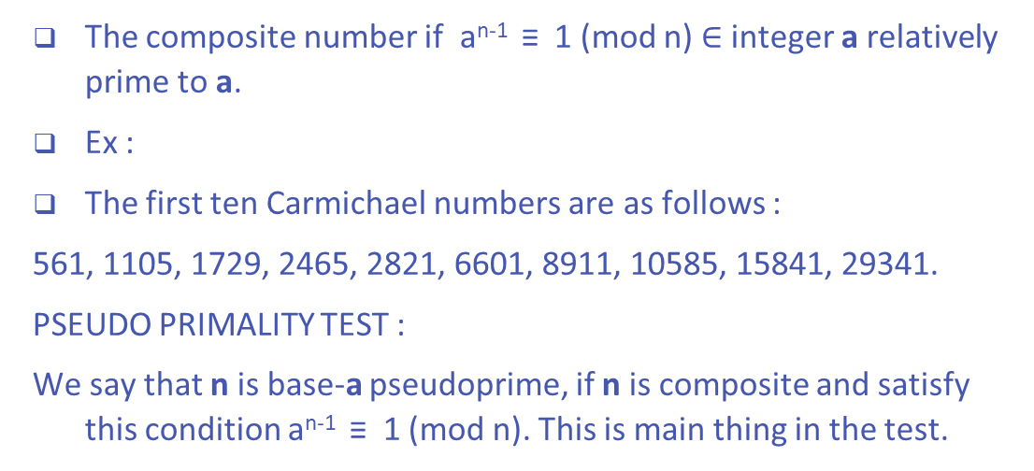
CARMICHAEL NUMBERS:
The composite number if a^{n-1} ≡ 1 (mod n) $∈$integer a relatively prime to a.
Ex :
The first ten Carmichael numbers are as follows :
561, 1105, 1729, 2465, 2821, 6601, 8911, 10585, 15841, 29341.
PSEUDO PRIMALITY TEST :
We say that n is base-a pseudoprime, if n is composite and satisfy this condition a^{n-1} ≡ 1 (mod n). This is main thing in the test.

Slide 12
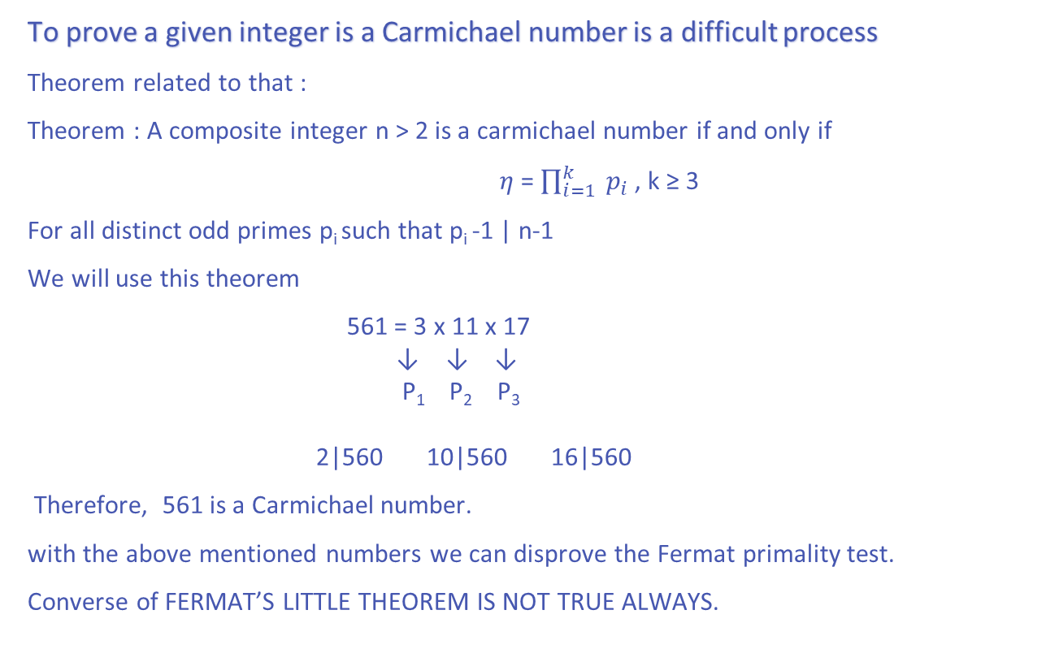
To prove a given integer is a Carmichael number is a difficult process
Theorem related to that :
Theorem : A composite integer n > 2 is a carmichael number if and only if
$η$ = $\prod_{i=1}^{k}{{ p}_{i}}$ , k ≥ 3
For all distinct odd primes p_{i} such that p_{i} -1 | n-1
We will use this theorem
561 = 3 x 11 x 17
↓ ↓ ↓
P₁ P₂ P₃
2|560 10|560 16|560
Therefore, 561 is a Carmichael number.
with the above mentioned numbers we can disprove the Fermat primality test.
Converse of FERMAT’S LITTLE THEOREM IS NOT TRUE ALWAYS.

Slide 13
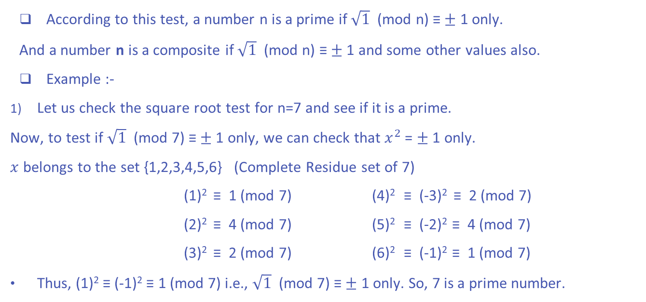
SQUARE ROOT TEST
According to this test, a number n is a prime if $\sqrt{1}$ (mod n) ≡ $±$ 1 only.
And a number n is a composite if $\sqrt{1}$ (mod n) ≡ $±$ 1 and some other values also.
Example :-
Let us check the square root test for n=7 and see if it is a prime.
Now, to test if $\sqrt{1}$ (mod 7) ≡ $±$ 1 only, we can check that $x^{2}$ = $±$ 1 only.
$x$ belongs to the set {1,2,3,4,5,6} (Complete Residue set of 7)
(1)² ≡ 1 (mod 7) (4)² ≡ (-3)² ≡ 2 (mod 7)
(2)² ≡ 4 (mod 7) (5)² ≡ (-2)² ≡ 4 (mod 7)
(3)² ≡ 2 (mod 7) (6)² ≡ (-1)² ≡ 1 (mod 7)
Thus, (1)² ≡ (-1)² ≡ 1 (mod 7) i.e., $\sqrt{1}$ (mod 7) ≡ $±$ 1 only. So, 7 is a prime number.

Slide 14
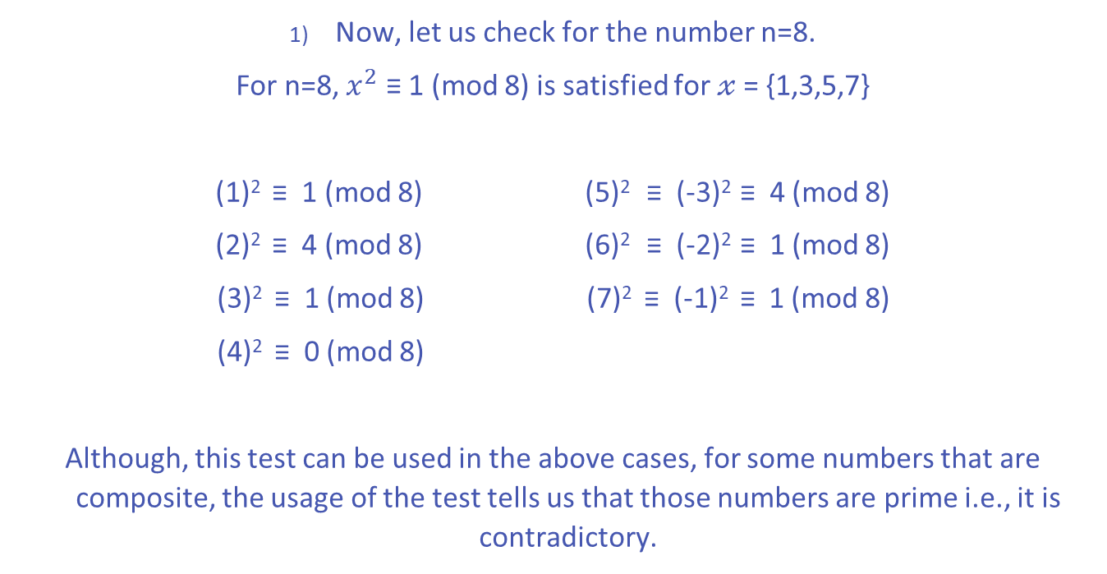
PRACTICAL USES:
Now, let us check for the number n=8.
For n=8, $x^{2}$ ≡ 1 (mod 8) is satisfied for $𝓍$ = {1,3,5,7}
(1)² ≡ 1 (mod 8) (5)² ≡ (-3)² ≡ 4 (mod 8)
(2)² ≡ 4 (mod 8) (6)² ≡ (-2)² ≡ 1 (mod 8)
(3)² ≡ 1 (mod 8) (7)² ≡ (-1)² ≡ 1 (mod 8)
(4)² ≡ 0 (mod 8)
Although, this test can be used in the above cases, for some numbers that are composite, the usage of the test tells us that those numbers are prime i.e., it is contradictory.

Slide 15
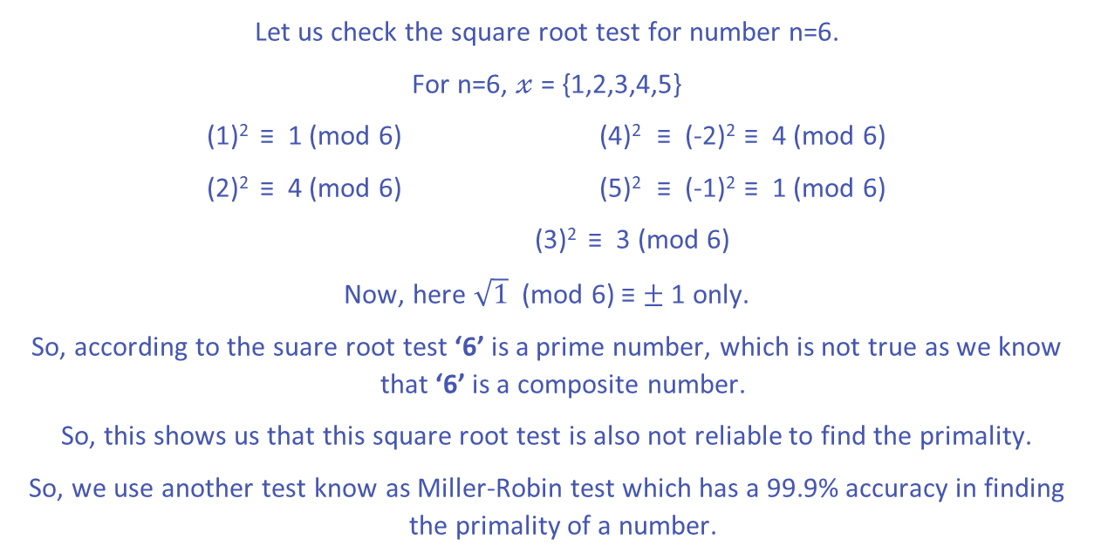
EXAMPLES:
Let us check the square root test for number n=6.
For n=6, $𝓍$ = {1,2,3,4,5}
(1)² ≡ 1 (mod 6) (4)² ≡ (-2)² ≡ 4 (mod 6)
(2)² ≡ 4 (mod 6) (5)² ≡ (-1)² ≡ 1 (mod 6)
(3)² ≡ 3 (mod 6)
Now, here $\sqrt{1}$ (mod 6) ≡ $±$ 1 only.
So, according to the suare root test ‘6’ is a prime number, which is not true as we know that ‘6’ is a composite number.
So, this shows us that this square root test is also not reliable to find the primality.
So, we use another test know as Miller-Robin test which has a 99.9% accuracy in finding the primality of a number.

Slide 16


